Slide 1

Unlocking Career Opportunities in Germany
Attique ur Rehman, Arshad Kazmi, Sajjad Hussain
Date: 15.10.2023

Slide 2
Agenda - Topics addressed during the presentation
Welcome
Introduction
Speaker-1 (20min): Arshad Kazmi Product Manager VMT Bruchsal Germany
Speaker-2 (20min) Atique ur Rehman Smart Factory - Digital Twin Engineer TiFS Rastatt Germany
Understanding German Job Market
Crafting a Winning German Style Resume
Key Data
Effective Job Search Technique
Interview Skills

Slide 3
Understanding German Job Market
Key Points:
Strong Economy: Germany boasts Europe's largest economy, offering diverse job opportunities.
Education Matters: A highly-educated workforce and emphasis on qualifications make education important.
Language: German language skills are mostly required, but English may be sufficient in some multinational companies.
Work-Life Balance: Germany values work-life balance, offering job security and generous benefits.
Job Seeker's Visa: Prevalent Job experienced Pakistanis can get job directly after obtaining blue card
Legal Aspects: Understand work permits

Slide 4
Crafting a Winning German Style Resume
Key Points:
Objective
Covering Detailed Skills
Result Oriented
Structured

Slide 5
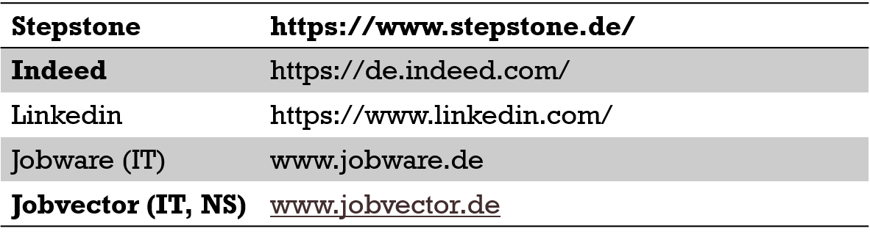
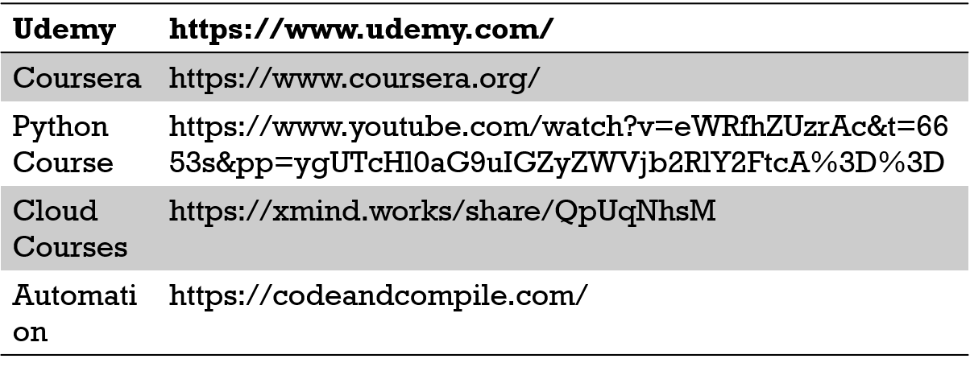
Useful Resources
Job Hunting Sites
Learning Platform

Slide 6
Effective Job Search Technique
Key Points:
Advance Search
Target Newer Jobs
Effective Keywords
Quick Apply

Slide 7
Interview Skills
Key Points:
Situation: Begin by describing the situation or context. Explain the background or scenario you were in.
Task: Explain the specific task or goal you needed to achieve within that situation. What were you trying to accomplish, and what were the expectations or challenges associated with it?
Action: Detail the actions you took to address the task or challenge. Describe what you did, step by step. Focus on your contributions and what you personally did to make a difference.
Result: Finally, share the outcome of your actions. What happened as a result of your efforts? Be specific about the positive results, impact, or achievements. Quantify your results when possible (e.g., "Increased sales by 20%" or "Reduced project completion time by two weeks").
STAR Approach
Complete JD Awareness
Pre-Interview Research: 2. Match Qualifications:
3. Customize Your Responses: 4. Behavioural Questions:
5. Ask Informed Questions: 6.Address Gaps or Concerns:
7. Company-Specific Integration:
Self Awareness
Know your strength and weakness
Communication
Clarity: Be concise and clear in your responses.
Active Listening: Pay attention to the interviewer's questions and respond thoughtfully.
Engagement: Maintain eye contact and positive body language.
Positivity: Stay positive and professional in your tone and language.
Relevance: Keep your responses directly related to the job and your qualifications.
Confidence: Exude confidence in your abilities and experiences.
Empathy: Show understanding and interest in the interviewer's perspective.

Slide 8
Thanks
Questions….
Email: atiq078@gmail.com

